Slide 1
Dynamic Wireless Mesh Network Load Balancing
Student: Matthew Winnan
Student Number: 18037497
Study Leader: Prof. S. Maharaj

Slide 2
Introduction:
A dynamic wireless routing algorithm was designed in order to connect multiple devices together in order to form a mesh network which allows a client to send a message packet to an intended destination.
The algorithm must be responsive in nature due to the constant change of the network topology. To this end a link monitor and repair system was put into place. A link is monitored by using Hallo packets and a link is repaired proactively or reactively based on the cause of link failure and if the link is part of an active route.
Further the algorithm must be able to quickly learn routes and discover new routes to a destination in order to maintain a stable connection.
Due to dynamic changes in link and device loads the algorithm must display load balancing capabilities in order to keep the device loads stable and minimize link failures.

Slide 3
Methodology:
The basic features of the routing protocol was based off of the AODV protocol. This allows multiple devices to reactively learn about neighbouring devices and on demand request a route to a destination. Requests are in the form of RREQ packets and the client node floods the network in search of a path to the destination. When one is found RREP packets are sent back to the origin node from the device that discovered to initial path.
In order to facilitate proactive route repair and enable the algorithm to perform load balancing the AODV protocol was extended into the existing AOMDV protocol. The path selection criteria was changed to allow multiple paths with the same hop count to be formed. Ultimately this allows a device to learn about multiple paths to a destination and allows the device to divide the link load to each device equally.
Proactive routing is achieved by having multiple routes to a destination as such when one route fails the backup route can immediately be used.

Slide 4
Methodology Continued:
Reactive link repair was accomplished by implementing the algorithm suggested by the AOMDV-LR protocol. Whenever a route link breaks the intermediate device sends a RREQ packet to rediscover a new route. If none could be found it notifies the next hop to the source of the route.
The link reliability protocol LR-AOMDV was considered but during testing it was found that due to the dynamic nature of the network the overall amount of discovered route go down and the previous selection criteria for the route might not be accurate anymore.
The device load was defined to be the average bytes that are sent or received to and from the current channel. Each device shares its load with a neighbour whenever a Hallo packet is received. When one is received the recipient responds with a R_ACK packet that contains the current device load information. This includes the ETX for the current link between the recipient and sender.

Slide 5
Problems During Implementation:
An unforeseen complication that arouse was due to the licensing nature of the LoRa network. As such proprietary binary files and compilers had to be used. During the course of development the mbedOS team released a new firmware update which caused problems when the binaries for the LoRa stack and the application had to be compiled and linked. As such some research and effort went into alternative solutions to compile the needed binaries.
The finite channel capacity of the network proved to be a challenge to manage. Naively the capacity of the channel was taken as a per device parameter but that is not how mesh networks work. As such the overall collision rates went up and the reliability of the network suffered. This was remedied by spreading out the maintenance packets by having each device send and respond to routing and maintenance packets at different rates.
Debugging the system proved to be difficult due to the dynamic nature of the network and due to the fact that in order for the network to continue operating as intended a device can not be paused in order to investigate the current registers. This was remedied by using print functions and the implemented serial interpreter.
Optimal network parameter assignment proved to be challenging due to unintended interactions or memory restrictions.

Slide 6
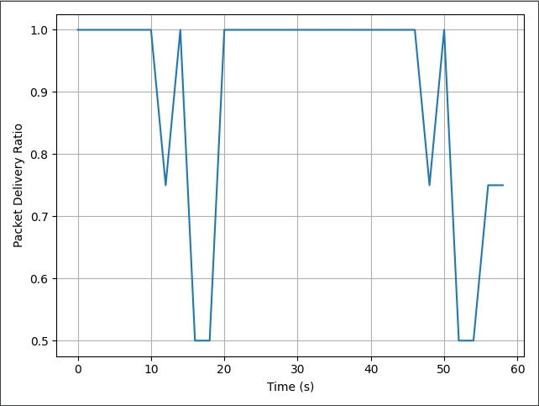
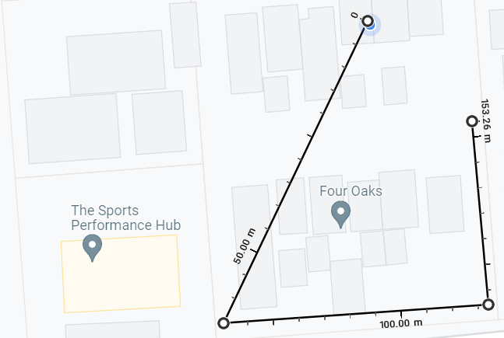
PDR From Driving Test:

Slide 7
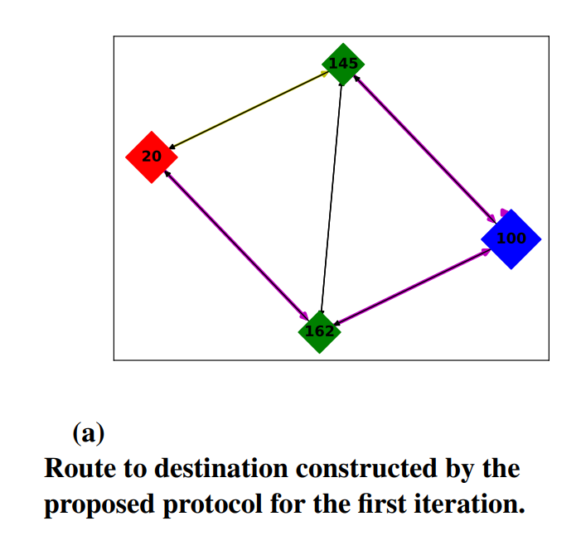
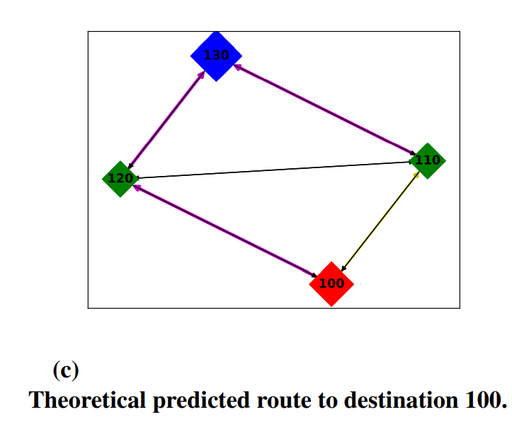
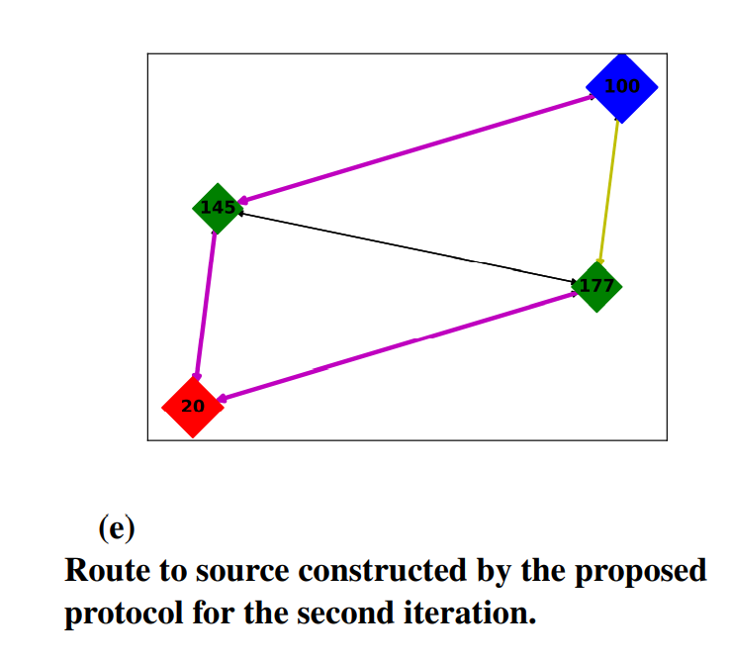
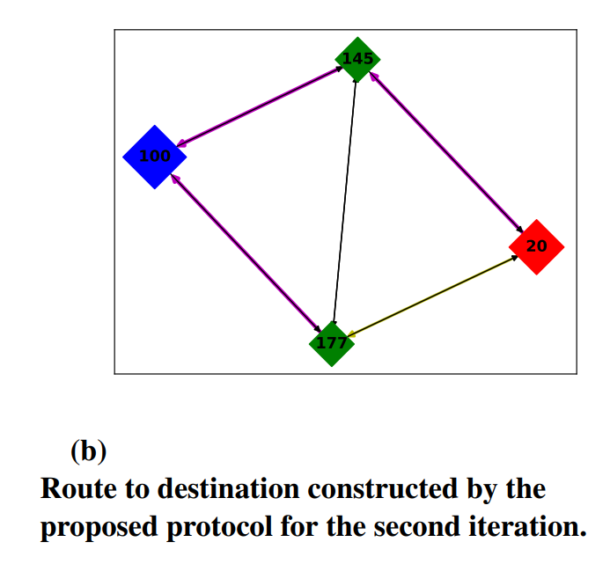
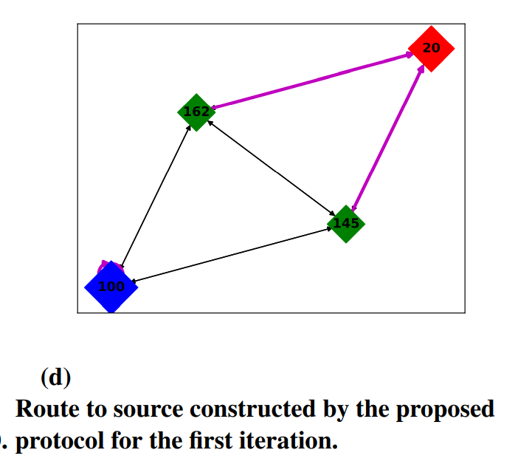
Obtained Network Topology:

Slide 8
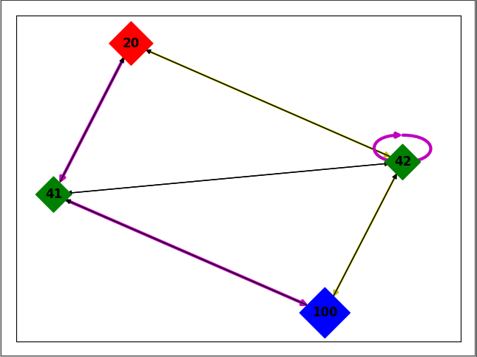
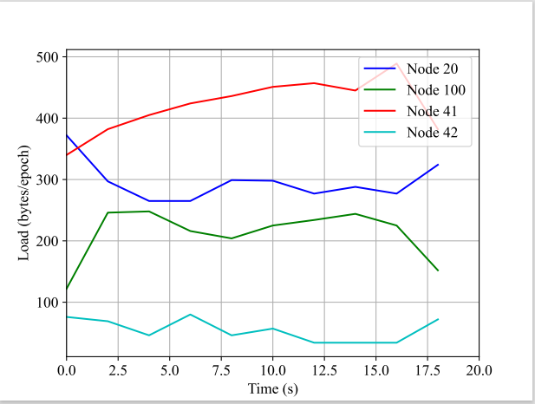
Practical Results Test 1:

Slide 9
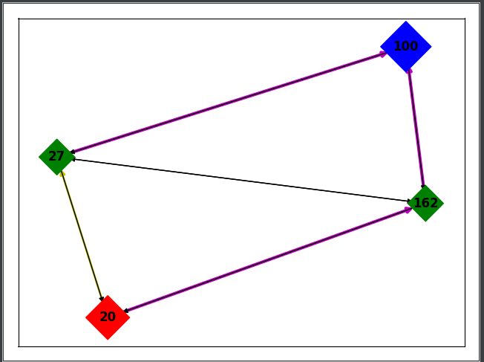
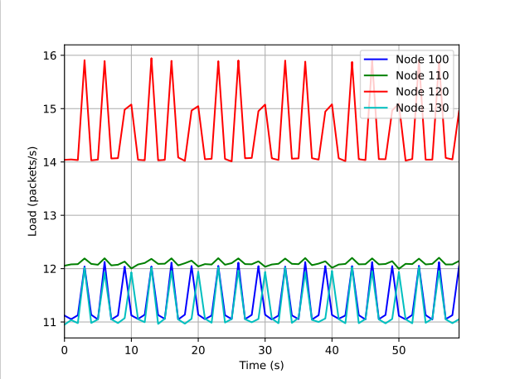
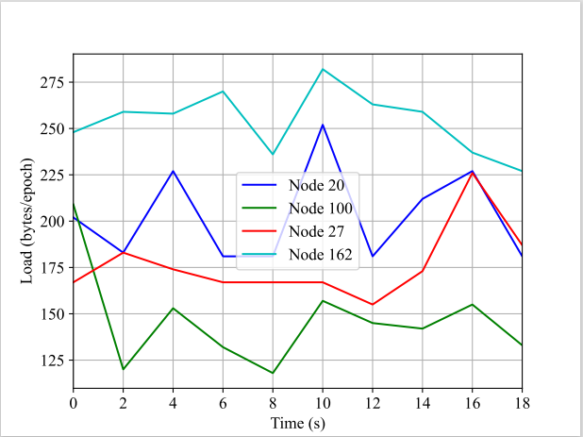
Practical Results Test 2:

Slide 10
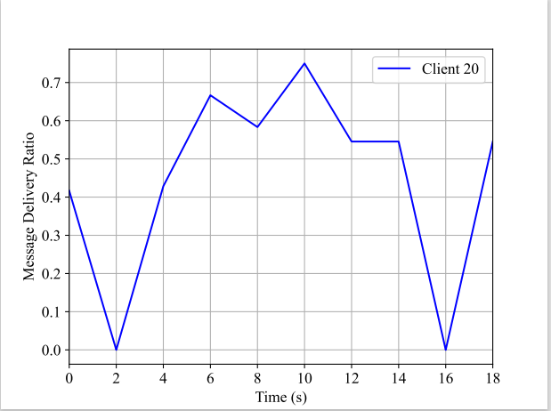
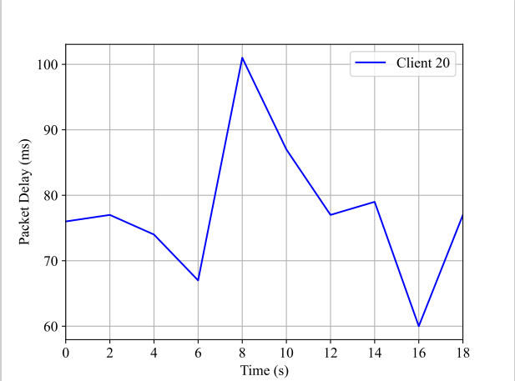
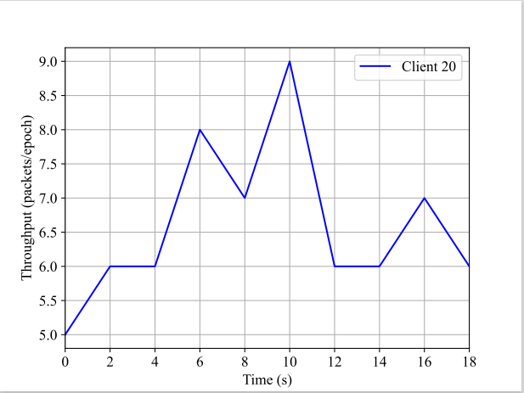
Practical Results Test 1 Continued:

Slide 11
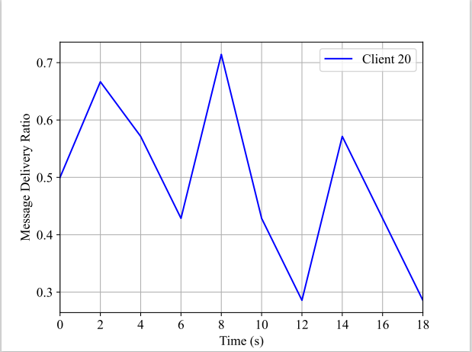
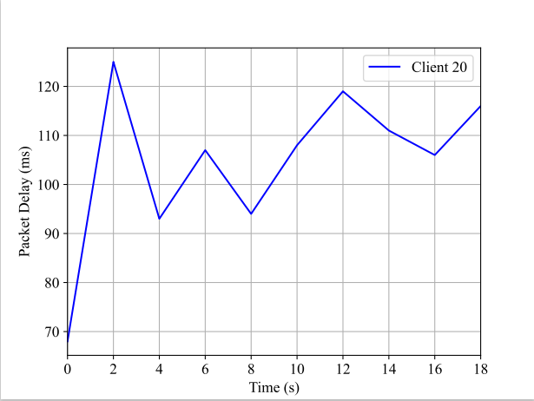
Practical Results Test 2 Continued:

